Slide 1



Meeting the energy needs of today and tomorrow
Aman Prakash (16180)

Slide 2

Blank slide
Agenda
Brief about (O&G)oil and gas industry
Crude oil
Sectors in O&G industry
Upstream / Midstream / Downstream
Brief about Chevron
Chevron competitors

Slide 3


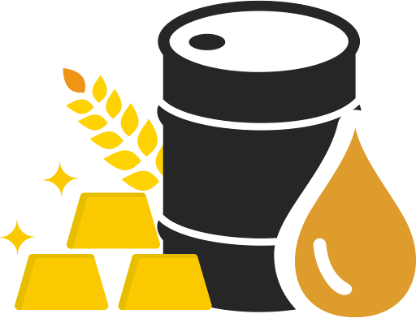

Blank slide
OIL & GAS
Industry
Powers the world
Engine of economy
Prices & trends
Risks and challenges

Slide 4
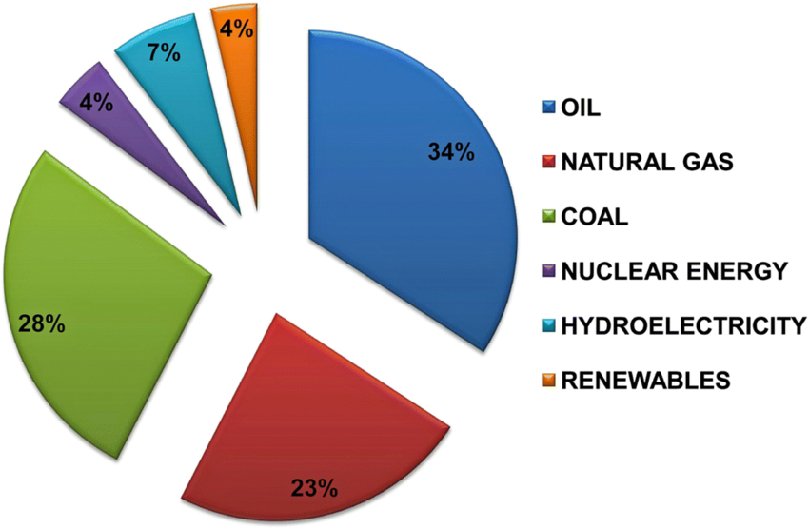
Blank slide
Powers the world
Engine of economy
Prices & trends
Risks and challenges
It is one of the biggest sectors in the world in terms of financial value and revenue.
Continuous growth because of global energy demand and its reliability.
percentage of different sources of energy used globally

Slide 5


Blank slide
Powers the world
Engine of economy
Prices & trends
Risks and challenges
Ranked 2nd among global industries in terms of revenue generated
The global oil and gas market size grew from $6,989.65 billion in 2022 to $7,330.80 billion in 2023

Slide 6

Blank slide
Powers the world
Engine of economy
Prices & trends
Risks and challenges
Factor affecting price of oil & gas:
Global supply & demand
Govt. policies and taxes
Logistics and infrastructure
Environmental policies
Currency fluctuations

Slide 7
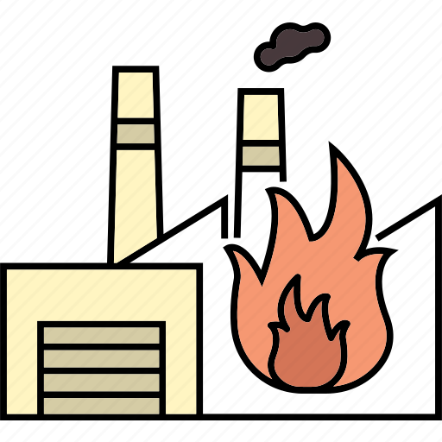



Blank slide
Powers the world
Engine of economy
Prices & trends
Risks and challenges
Risks faced by Oil & Gas Companies:
Environmental Risks
Safety Risks
Supply and Demand Risks
Financial Risks
Cyber Risks

Slide 8
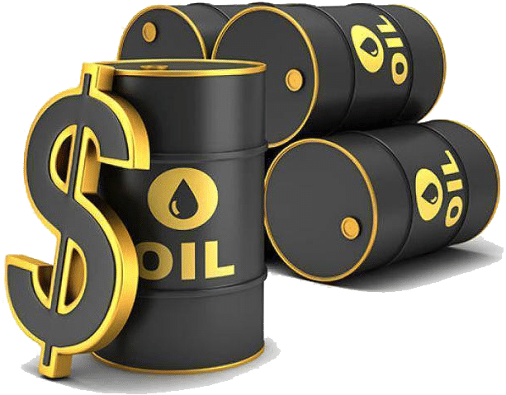
Blank slide
Crude Oil
A naturally occurring, unrefined petroleum product composed of hydrocarbon deposits.
Often referred to as “BLACK GOLD”
The ideal oil is light and sweet with a low TAN count
Light oil – Lower density
(produces a greater percentage of gasoline)
Sweet oil – Lower Sulphur level
( well under 1%)
TAN count – Total acid number
(measure of how corrosive it is)

Slide 9



Blank slide
Sectors of Oil and Gas industry
Upstream
Midstream
Downstream
Finding & extracting oil and gas
Transporting & storing oil and gas
Refining, marketing & retailing oil and gas

Slide 10
Blank slide
Upstream
Midstream
Downstream
Exploration Activity
Drilling Activity
Surface methods
Offshore & Onshore
Gravity and magnetic surveys
Conventional & Unconventional
Seismographic methods
Pad drilling

Slide 11
Blank slide
Upstream
Midstream
Downstream
Exploration Activity
Surface method
Gravity and magnetic survey
Seismographic method
geological observations and interpretations
measuring local anomalies in the Earth’s magnetic fields
most valuable technique
such as petrography
sedimentology
structural geology geochemistry
identify anomalies in the gravity acceleration generated by contrasts in density among bodies in the subsurface
by use of seismic waves, a 3D plot of underground structure is observed for oil and gas reservoirs

Slide 12




Blank slide
Upstream
Midstream
Downstream
Midstream refers to points in the oil production process that falls between upstream and downstream
Includes transportation of crude or refined petroleum products, usually via pipeline, oil tanker, truck, rail or airlines

Slide 13


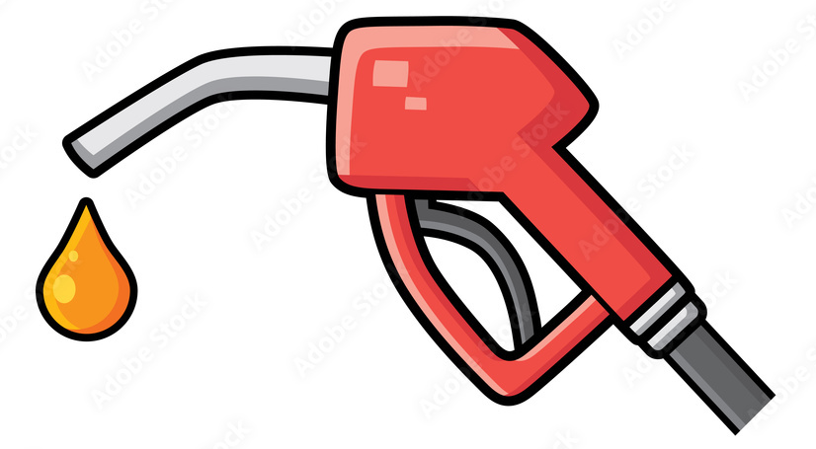
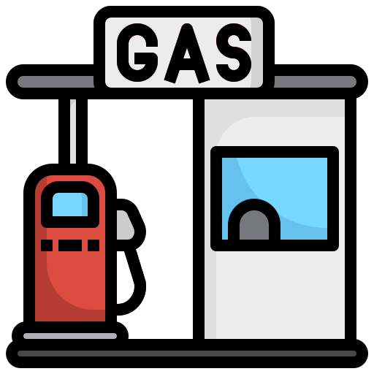
Blank slide
Upstream
Midstream
Downstream
Final stage of the process and refers to the refining, processing and purifying of crude oil and natural gas
Marketing and distribution of crude oil and natural gas related products
This includes manufacturing products such as petrol, gasoline, diesel oil, jet fuel, lubricants, heating oil, asphalt, waxes etc.

Slide 14



Blank slide
Drilling
Based on location:
Onshore - drilling earth’s surface
Offshore - drilling underneath the seabed
Offshore rig
Based on type of gas wells:
Conventional - vertical drilling, yields less oil
Unconventional - horizontal drilling and hydraulic fracturing
Onshore conventional rig
Fracking, is the process of injecting water, sand, and/or chemicals into a well to break up underground bedrock to free up oil or gas reserves
Horizontal drilling

Slide 15


Slide 16

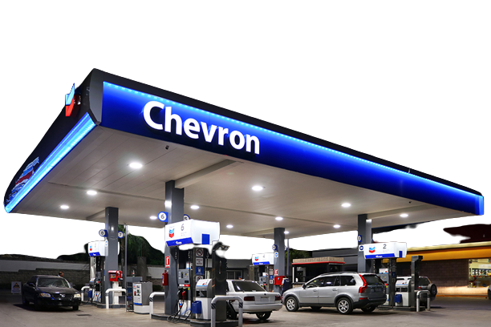
Blank slide
Chevron Corporation is a multinational energy corporation headquartered in San Ramon, California, United States. Founded in September 1879.
It is active in more than 180 countries worldwide and has a brand value of nearly 15 billion U.S. dollars, raking 7th among worldwide oil and gas companies.
It ranked 10th on the Fortune 500 in 2023.

Slide 17


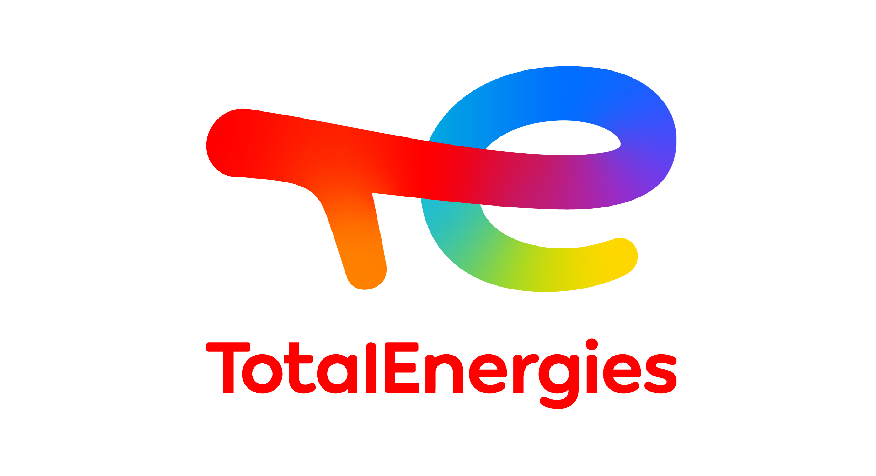



Blank slide
COMPETITORS OF CHEVRON
British Petroleum

Slide 18
Blank slide
Thank You
Presented by Aman Prakash (16180)

